Slide 1
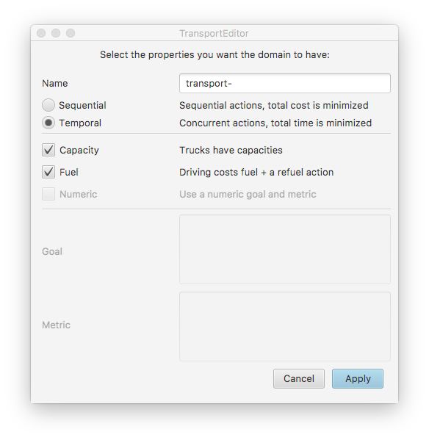
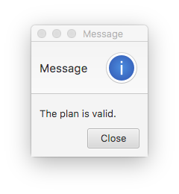
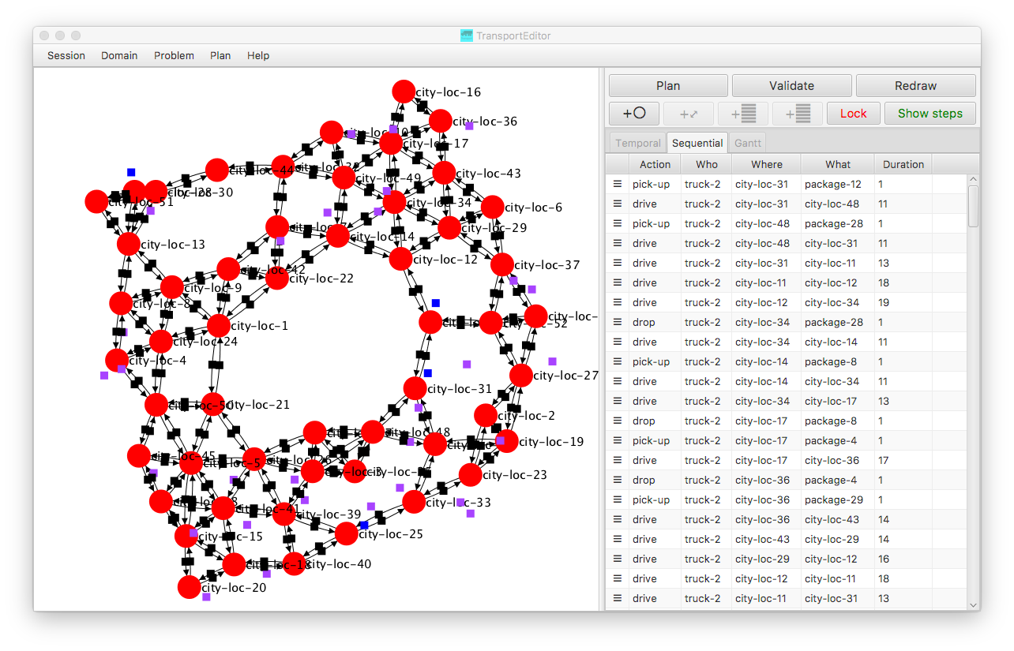
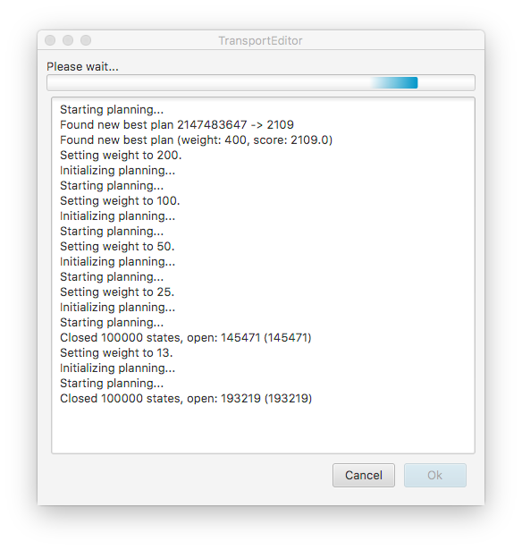


TransportEditor: Creating and Visualizing Transportation Problems and Plans Ondrej Škopek, Roman Barták Charles University, Faculty of Mathematics and Physics, Malostranské nám. 25, 118 00 Praha, Czech Republic bartak@ktiml.mff.cuni.cz (contact e-mail)
1. Aim and Motivation
Provide a portable system for easy editing of transportation planning domain models and problems that supports planning, plan validation and dynamic visualization.
3. Domain and Problem Editing
It is possible to use existing domain models from IPC, or
to create own domain model and save it in PDDL.
sequential and temporal versions supported
limited capacity and fuel consumption supported
It is possible to use existing problems in PDDL, or
to create own problems.
Each problem consists of
network of locations
positions of trucks
positions of refueling stations
positions (and destinations) of packages
5. Plan Visualization and Tracing
Plan can be shown as a sequence of actions or a Gantt chart.
Plan can be traced while showing current positions of trucks/packages in the network.
2. Transport Domain
Transport domain is a logistic-type domain, where trucks transport packages from one location to another using a network of connections.
Major actions are pick-up, drive, and drop.
Trucks (usually) have limited capacity.
Driving takes some time/cost.
Trucks may have limited fuel capacity; fuel is consumed by driving; trucks can be refueled at specific locations.
Actions may be durative.
Variants used at IPC-6, IPC-7, IPC-8.
6. Plan Validation
Internal validation of sequential plans, or
any external validator such as VAL.
4. Action Planning
Several built-in ad-hoc planners (heuristic search with pruning and restarts) available, or
any external planner can be called
Download me!
Supported by the Czech Science Foundation under the project P103-15-19877S.

